Slide 1
Course Title - Arial 34 pt
Topic Title - Arial 26 pt
Presenter’s Name - Arial 18 pt
Presenter’s ID - Arial 18 pt
Department Name - Arial 18 pt
Lecture Number - Arial 18 pt
Presentation Date - Arial 18 pt

Slide 2
Course Outcomes Arial 30 pt
At the end of the course, students should be able to: Arial 21 pt
  CO1: write CO1 here.
  CO2: write CO2 here.
  CO3: write CO3 here.

Slide 3
Title Name

Slide 4
Title Name
Bar Chart Name

Slide 5
Title Name
Bar Chart Name

Slide 6
Title Name
Bar Chart Name

Slide 7
Title Name
Graph Chart Name

Slide 8
Title Name
Table Chart Name
Title | Subject Title | Subject Title
Title 1 | Data | XX%
Title 2 | Data | XX%
Title 3 | Data | XX%
Title 4 | Data | XX%
Title 5 | Data | XX%
Title 6 | Data | XX%
Total | Data Total

Slide 9
“A stand-alone slide option for a quote - Arial 30 - 48 pt”
—Author’s Name - Arial 24 - 28 pt

Slide 10
Title Name

Slide 11

Title Name
This slide has text and an image.

Slide 12
Title Name
This slide has text and bar chart.

Slide 13
Title Name
This slide has text and table.
Title | Subject Title | Subject Title
Title 1 | Data | XX%
Title 2 | Data | XX%
Title 3 | Data | XX%
Title 4 | Data | XX%
Title 5 | Data | XX%
Title 6 | Data | XX%
Total | Data Total

Slide 14
Title Name

Slide 15
Sum of Two Integers
def getSum(a, b):
s=[]
s.append(a)
s.append(b)
return sum(s)
Given two integers a and b, return the sum of the two integers without using the operators + and -.
Example 1:
Input: a = 1, b = 2 Output: 3
Example 2:
Input: a = 2, b = 3 Output: 5

Slide 16
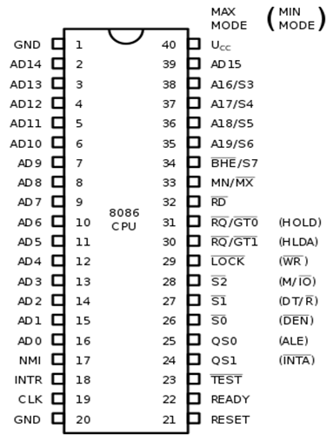
8086 Pins Configuration
A16/S3, A17/S4: A16 and A17 are multiplexed with segment identifier signals S3 and S4.
A18/S5: A18 is multiplexed with interrupt status S5.
A19/S6: A19 is multiplexed with status signal S6.

Slide 17
Title Name
Subtitle
Subtitle

Slide 18
Title Name

Slide 20
Thank You - Arial 34 pt

