Slide 1
Course Title - Arial 34 pt
Topic Title - Arial 26 pt
Presenter’s Name - Arial 18 pt
Presenter’s ID - Arial 18 pt
Department Name - Arial 18 pt
Lecture Number - Arial 18 pt
Presentation Date - Arial 18 pt

Slide 2
Course Outcomes Arial 30 pt
At the end of the course, students should be able to: Arial 21 pt
  CO1: write CO1 here.
  CO2: write CO2 here.
  CO3: write CO3 here.

Slide 3
Title Name

Slide 4
Title Name
Bar Chart Name

Slide 5
Title Name
Bar Chart Name

Slide 6
Title Name
Bar Chart Name

Slide 7
Title Name
Graph Chart Name

Slide 8
Title Name
Table Chart Name
Title | Subject Title | Subject Title
Title 1 | Data | XX%
Title 2 | Data | XX%
Title 3 | Data | XX%
Title 4 | Data | XX%
Title 5 | Data | XX%
Title 6 | Data | XX%
Total | Data Total

Slide 9
“A stand-alone slide option for a quote - Arial 30 - 48 pt”
—Author’s Name - Arial 24 - 28 pt

Slide 10

Title Name
This slide has text and an image.

Slide 11
Title Name
This slide has text and bar chart.

Slide 12
Title Name
This slide has text and bar chart.
Title | Subject Title | Subject Title
Title 1 | Data | XX%
Title 2 | Data | XX%
Title 3 | Data | XX%
Title 4 | Data | XX%
Title 5 | Data | XX%
Title 6 | Data | XX%
Total | Data Total

Slide 13
Title Name

Slide 14
Sum of Two Integers
Given two integers a and b, return the sum of the two integers without using the operators + and -.
Example 1:
Input: a = 1, b = 2 Output: 3
Example 2:
Input: a = 2, b = 3 Output: 5
def getSum(a, b):
s=[]
s.append(a)
s.append(b)
return sum(s)

Slide 15
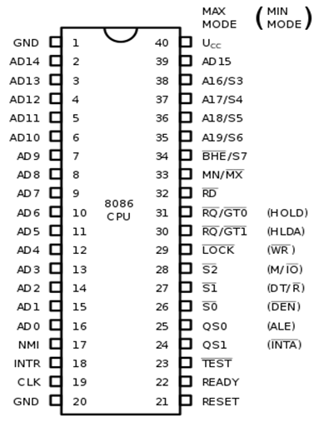
8086 Pins Configuration
Given two integers a and b, return the sum of the two integers without using the operators + and -.
Example 1:
Input: a = 1, b = 2 Output: 3
Example 2:
Input: a = 2, b = 3 Output: 5

Slide 16
Title Name

Slide 17
Title Name
Subtitle
Subtitle

Slide 18
Title Name

Slide 20
Thank You - Arial 34 pt

